Slide 1


DATA MINING
COURSE PROJECT
Predicting the presence/absence of Cardiovascular Disease

Slide 2
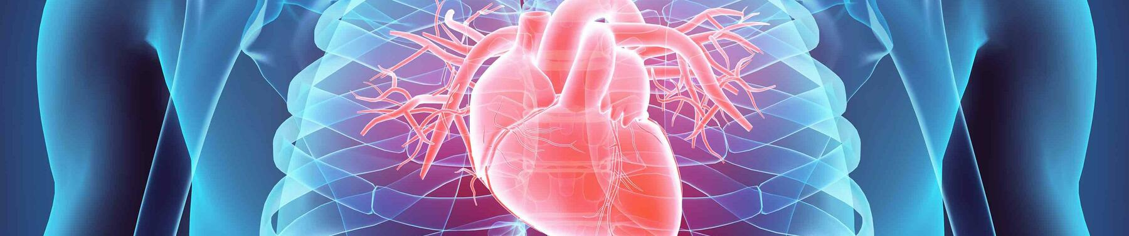
TABLE OF CONTENT
Introduction
Dataset Description
Features
Data Preprocessing
Learning models

Slide 3
Introduction
Heart disease problem is a widespread fatal disease and is currently the number one killer of the global population.
According to the World Health Organization report, cardiovascular disease kills 17.9 million people every year, accounting for about 32% of the world’s deaths.
Context:
In this challenge, data consists of standard health information.
In this dataset, we try to predict the presence or absence of cardiovascular disease.

Slide 4

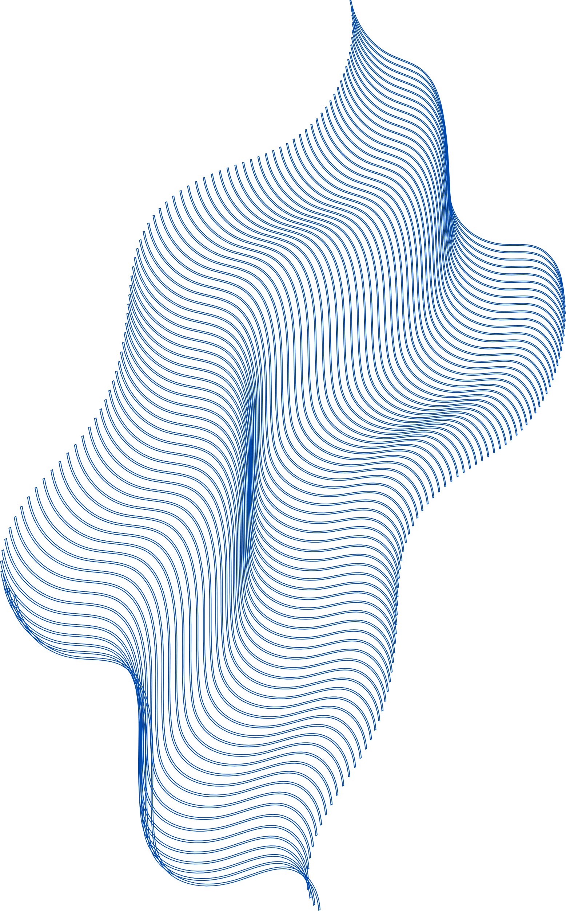
Dataset Description
Training data
x-train:
Rows 53433
Columns 11
y-train:
Rows 53433
Testing data
x-test:
Rows 13359
Columns 11
The dataset is split into a 70/30 ratio, with 70% allocated for training and 30% for testing

Slide 5

Features
Age - int (days)
Height - int (cm)
Weight - float (kg
Gender - categorical code
ap_hi (Systolic blood pressure) - int
ap_lo(Diastolic blood pressure) - int
cholesterol - 1: normal, 2: above normal, 3: well above normal
glucose - 1: normal, 2: above normal, 3: well above normal
smoking - binary
alco - binary
active - binary
cardio - binary
Target:
Cardio - binary
(Presence or absence of cardiovascular disease)

Slide 6
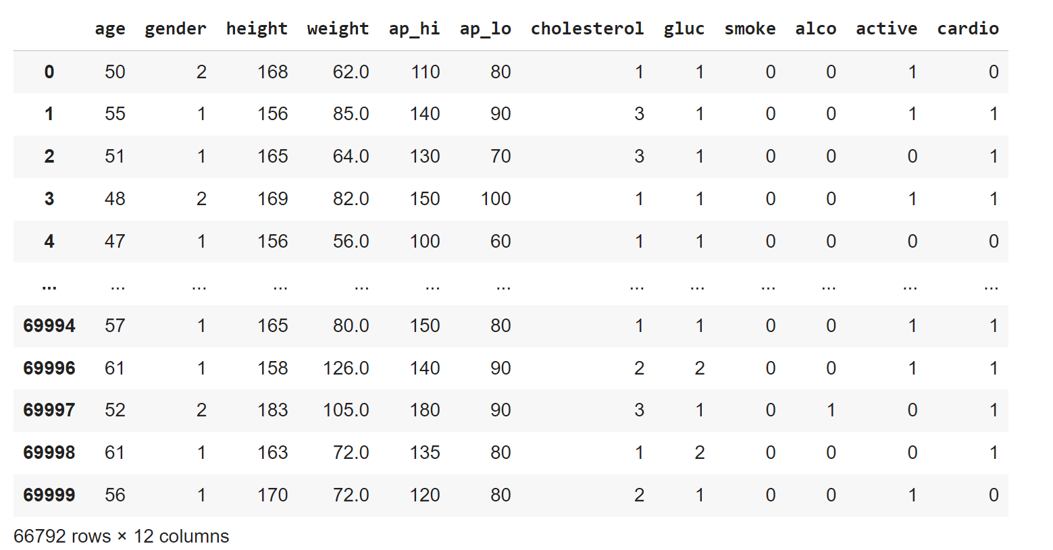
Attributes
Fig 1.0 – Displaying Attributes

Slide 7
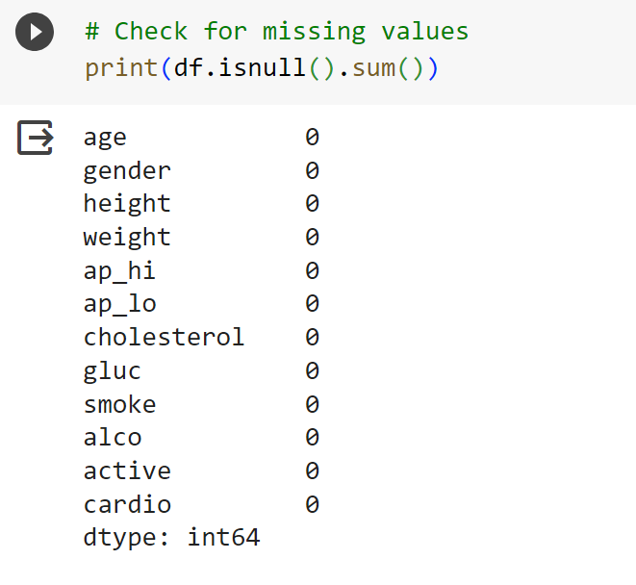
Data Preprocessing
The data has to be pre-processed before it can be fed to any learning model.
For pre-processing the following steps were taken:
There are no null values in each column.
fig 2.0 - NULL values in attributes

Slide 8
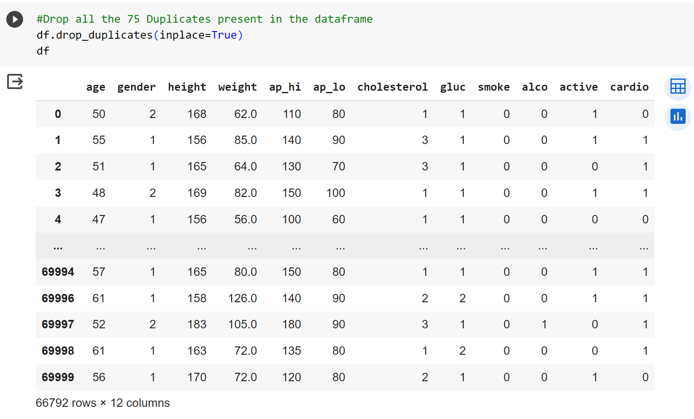
Data Preprocessing
Dropping unwanted ID column
Dropping the duplicate values
fig 3.0 – Dropping Duplicate values

Slide 9
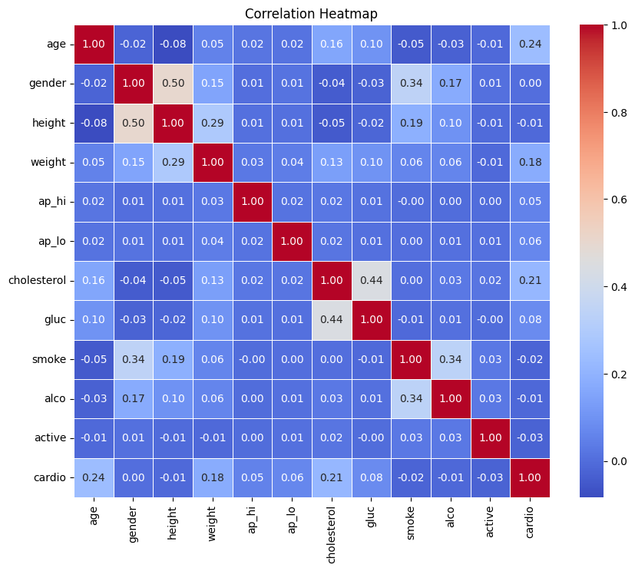
Data Visualization
Correlation Heat Map
fig 4.0 – Heat Map

Slide 10
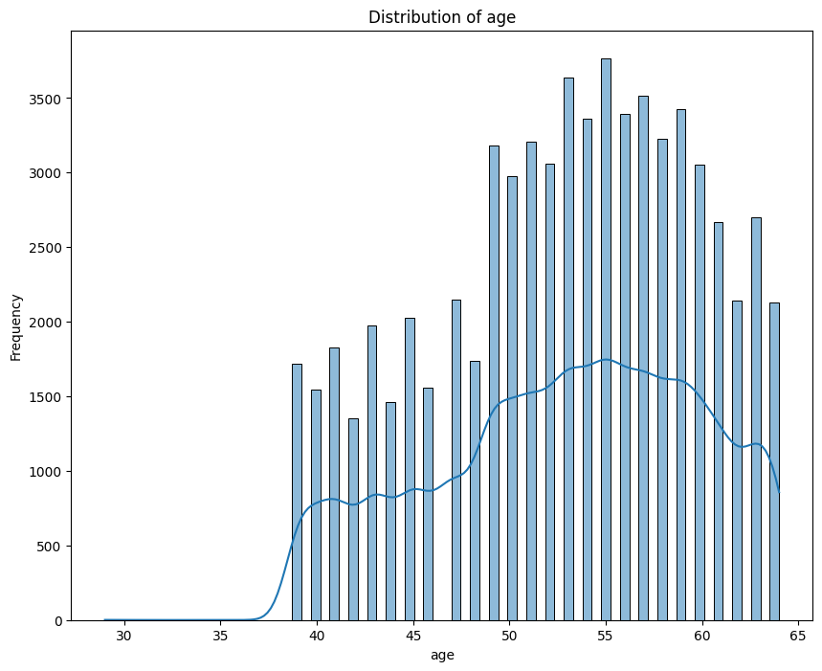
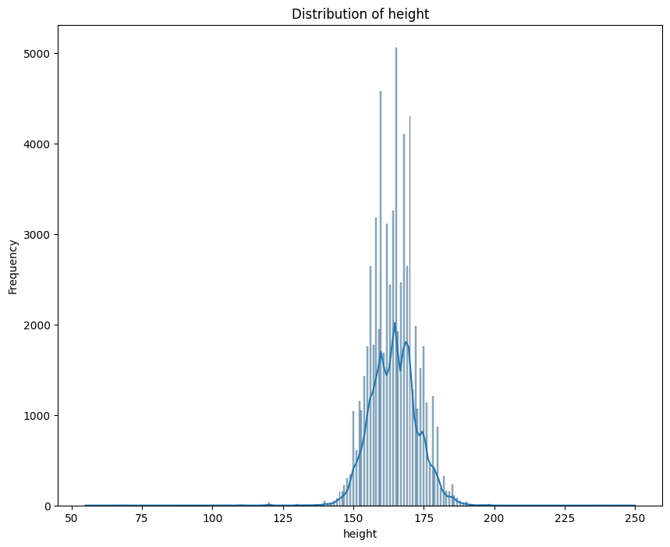
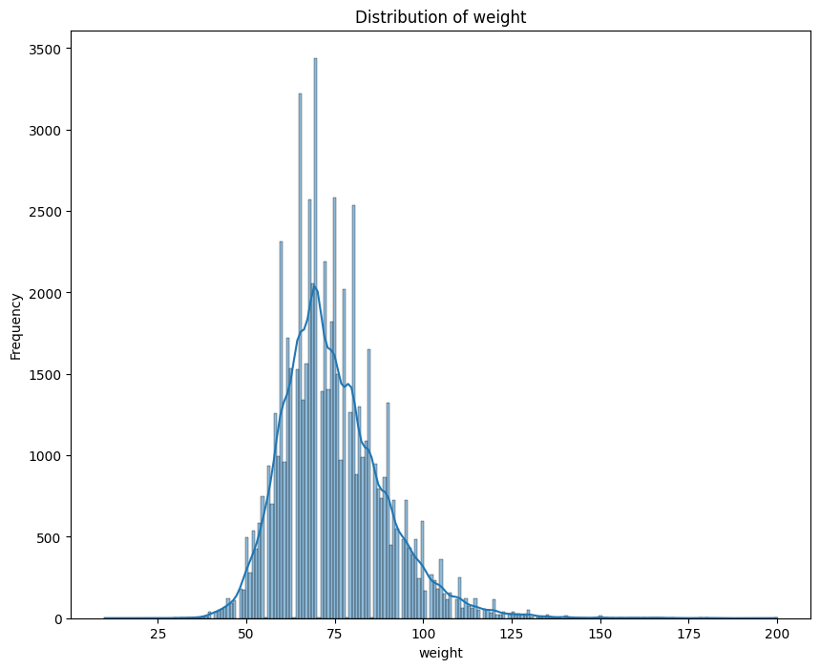
2. distribution of age, height, weight
fig 5.0 – Distribution of age
fig 6.0 – Distribution of height
fig 7.0 – Distribution of age

Slide 11
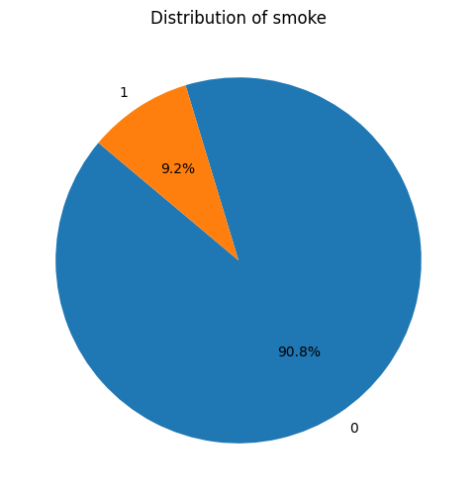
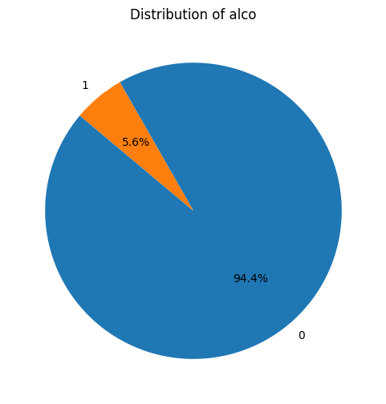
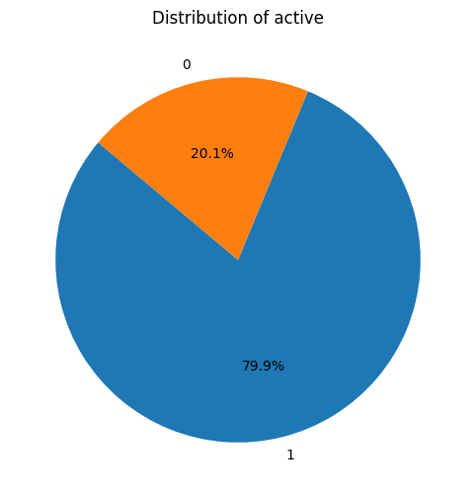
3. distribution of Smoking, Alcohol intake, Physical activity, Glucose, Cholesterol
fig 8.0 – Distribution of smoking
fig 9.0 – Distribution of alcohol
fig 10.0 – Distribution of activity

Slide 12
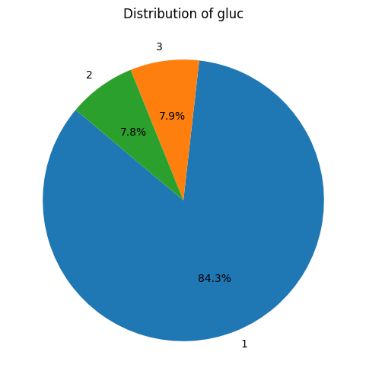
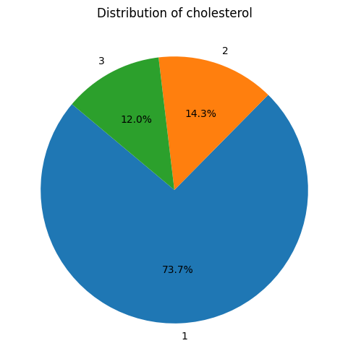
fig 11.0 – Distribution of glucose
fig 12.0 – Distribution of cholesterol

Slide 13
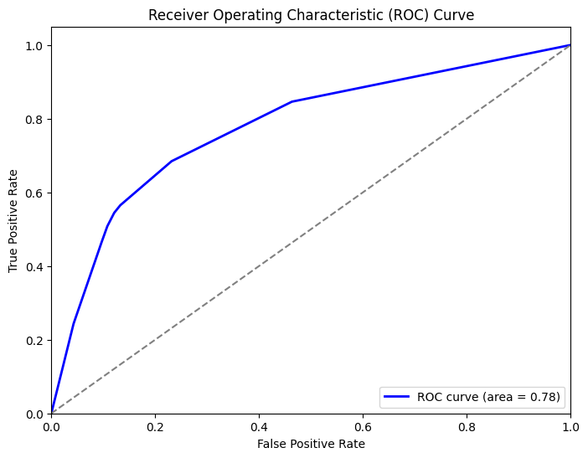
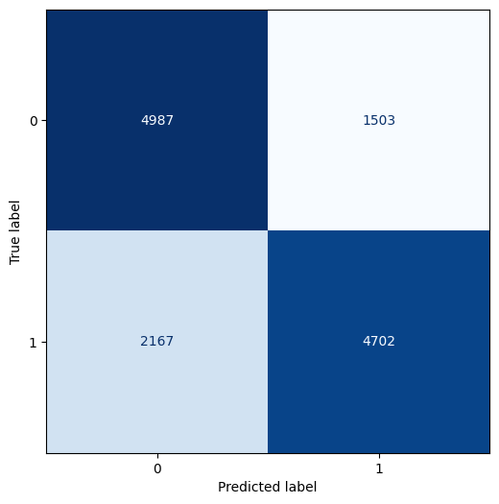
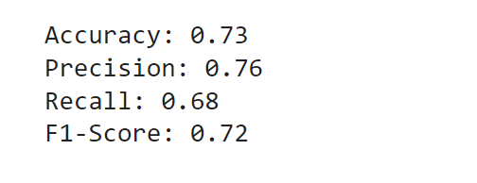
Training Models
1. Decision Tree
fig 13.0 – ROC Curve
fig 15.0 – Performance Metric
fig 14.0 – Confusion Matrix

Slide 14
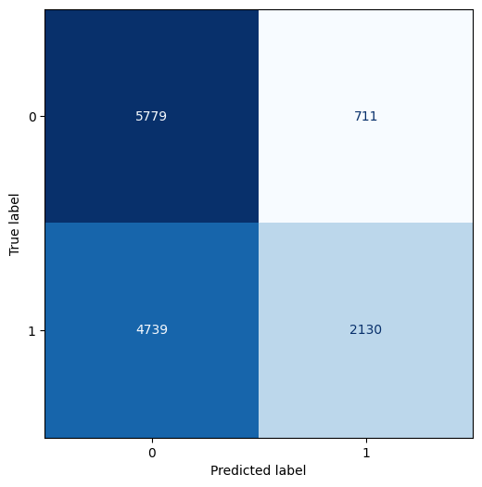
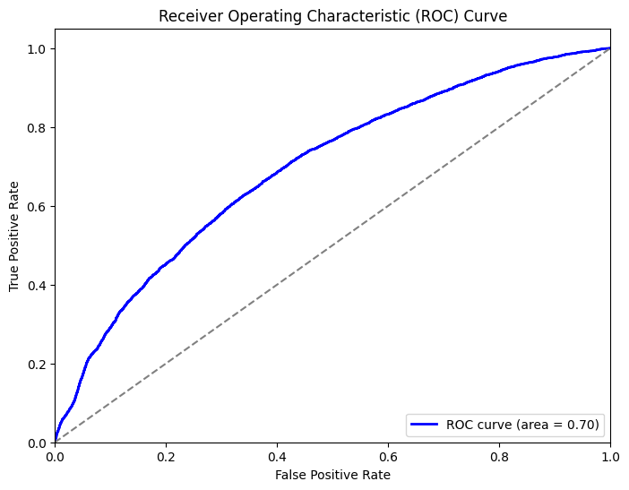
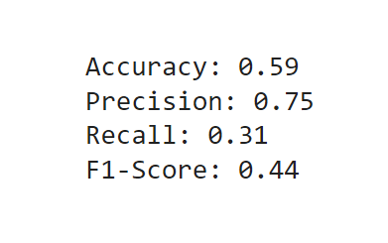
Training Models
2. Naïve Bayes
fig 16.0 – ROC Curve
fig 17.0 – Confusion Matrix
fig 18.0 – Performance Metric

Slide 15
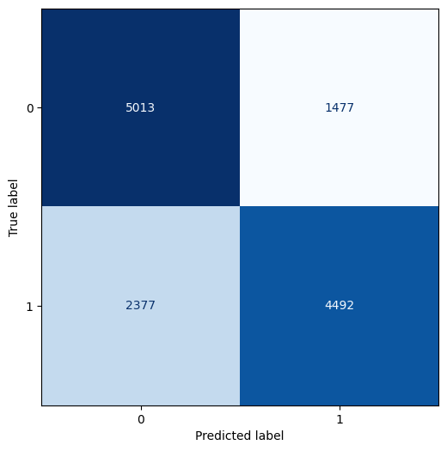
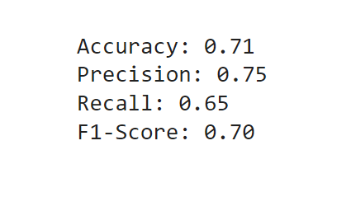
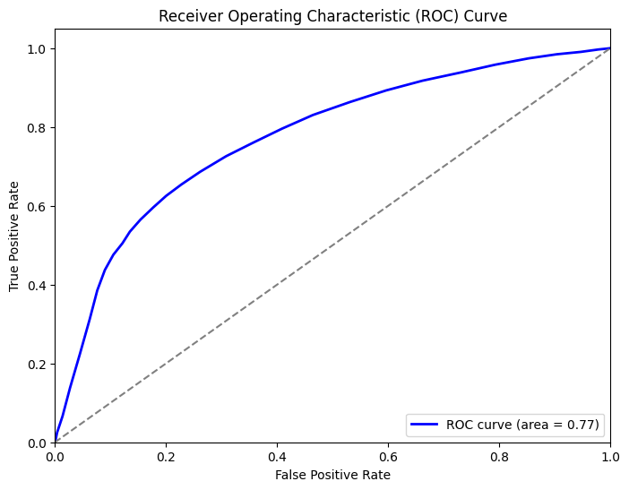
Training Models
3. K nearest Neighbor
fig 19.0 – ROC Curve
fig 20.0 – Confusion Matrix
fig 21.0 – Performance Metric

Slide 16
Training Models
4. Neural Network (MLP Classifier)
fig 23.0 – Performance Metric
fig 22.0 – Confusion Matrix

Slide 17
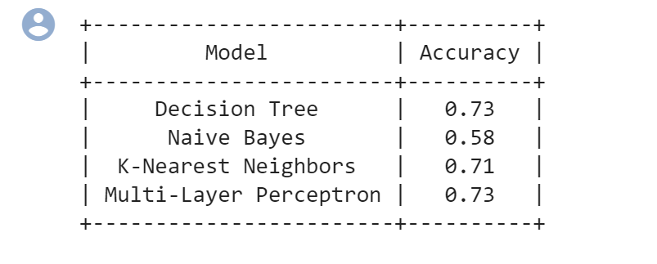
Conclusion
Since Decision Tree and MLP has higher efficiency and faster training speed, which gives Better accuracy than other applied models and even Data of large-scale can be handled by these models in a better way. We have considered Decision Tree and MLP Classifier.

Slide 18
THANK
YOU

